Slide 1
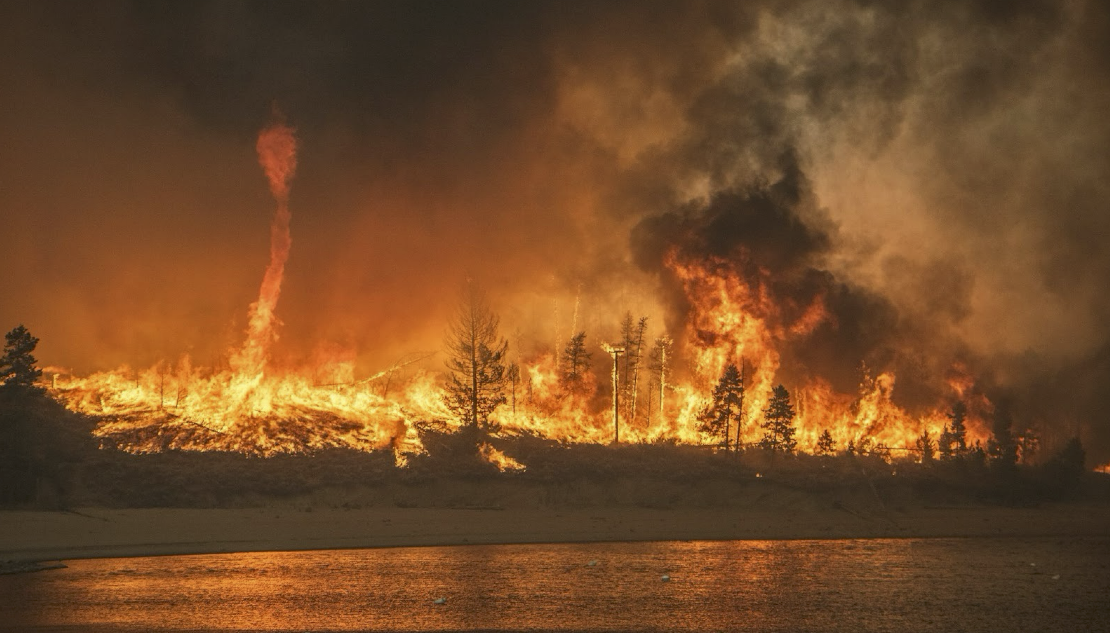
The Fastest and Most Destructive Fires in the U.S. (2001-2020)
Jennifer K. Balch^{1,2*}, Virginia Iglesias^{1,3†}, Adam L. Mahood^{4†}, Maxwell C. Cook (presenting author)^{2,3}, Cibele Amaral^{1,3}, Amy DeCastro⁵, Stefan Leyk², Tyler L. McIntosh³, R. Chelsea Nagy^{1,3}, Lise St. Denis³, Ty Tuff^{1,3}, Erick Verleye^{1,3}, A. Park Williams⁶, Crystal A. Kolden⁷
Notes:
Welcome everyone, thank you for being here this afternoon. I know personally it has been a long week, so we appreciate you being here for one of the last sessions of this year's conference.
My name is Maxwell Cook, I am PhD candidate with Dr. Jennifer Balch in the Department of Geography at the University of Colorado at Boulder.
I am honored and privileged to be here today to present some exciting new research as part of a large collaborative team of amazing scientists, many of whom are here in this room today.
In this work, we have documented the fastest and most destructive wildfires in the United States between 2001-2020.

Slide 2
Land Acknowledgment
As we gather, we honor and acknowledge that the Lands now called Colorado are the traditional territories and ancestral homelands of the Cheyenne, Arapaho, Ute, Apache, Comanche, Kiowa, Lakota, Pueblo and Shoshone Nations. Further, we acknowledge the 48 contemporary tribal nations historically tied to the lands that comprise what is now called Colorado.
Acknowledging that we live in the homelands of Indigenous peoples recognizes the original stewards of these lands and their legacies. With this land acknowledgment, we celebrate the many contributions of Native peoples to the fields of medicine, mathematics, government and military service, arts, literature, engineering and more. We also recognize the sophisticated and intricate knowledge systems Indigenous peoples have developed in relationship to their lands.
We recognize and affirm the ties these nations have to their traditional homelands and the many Indigenous people who thrive in this place, alive and strong. We also acknowledge the painful history of ill treatment and forced removal that has had a profoundly negative impact on Native nations.
Notes:
Before we dive in, I would like to acknowledge that the lands I live and work on are the traditional territories and ancestral homelands of the Cheyenne, Arapaho, Ute, Apache, Comanche, Kiowa, Lakota, Pueblo and Shoshone Nations along with 48 contemporary tribal nations historically tied to the lands that comprise what is now called Colorado.
I would also like to acknowledge the Gabrielino/Tongva peoples as the traditional land caretakers of Tovaangar (Los Angeles basin, So. Channel Islands), where this conference is being held.

Slide 3
Notes:
Many in this room have likely experienced either direct or indirect impacts from wildfires.
Fire is also an integral component many ecosystems and our landscapes and cultures have been shaped by fire over time. I want to acknowledge this fact, understanding that while fires can have negative consequences on communities, not all fire is bad fire.

Slide 4
Some of the deadliest and most destructive wildfires in contemporary U.S. history have occurred in recent years, with most having the common characteristic of extremely rapid growth.
Notes:
With that said {CLICK}, Some of the most destructive and deadly wildfires in recent U.S. history had the common characteristic of extremely rapid growth. In other words, these fires were also fast.

Slide 5
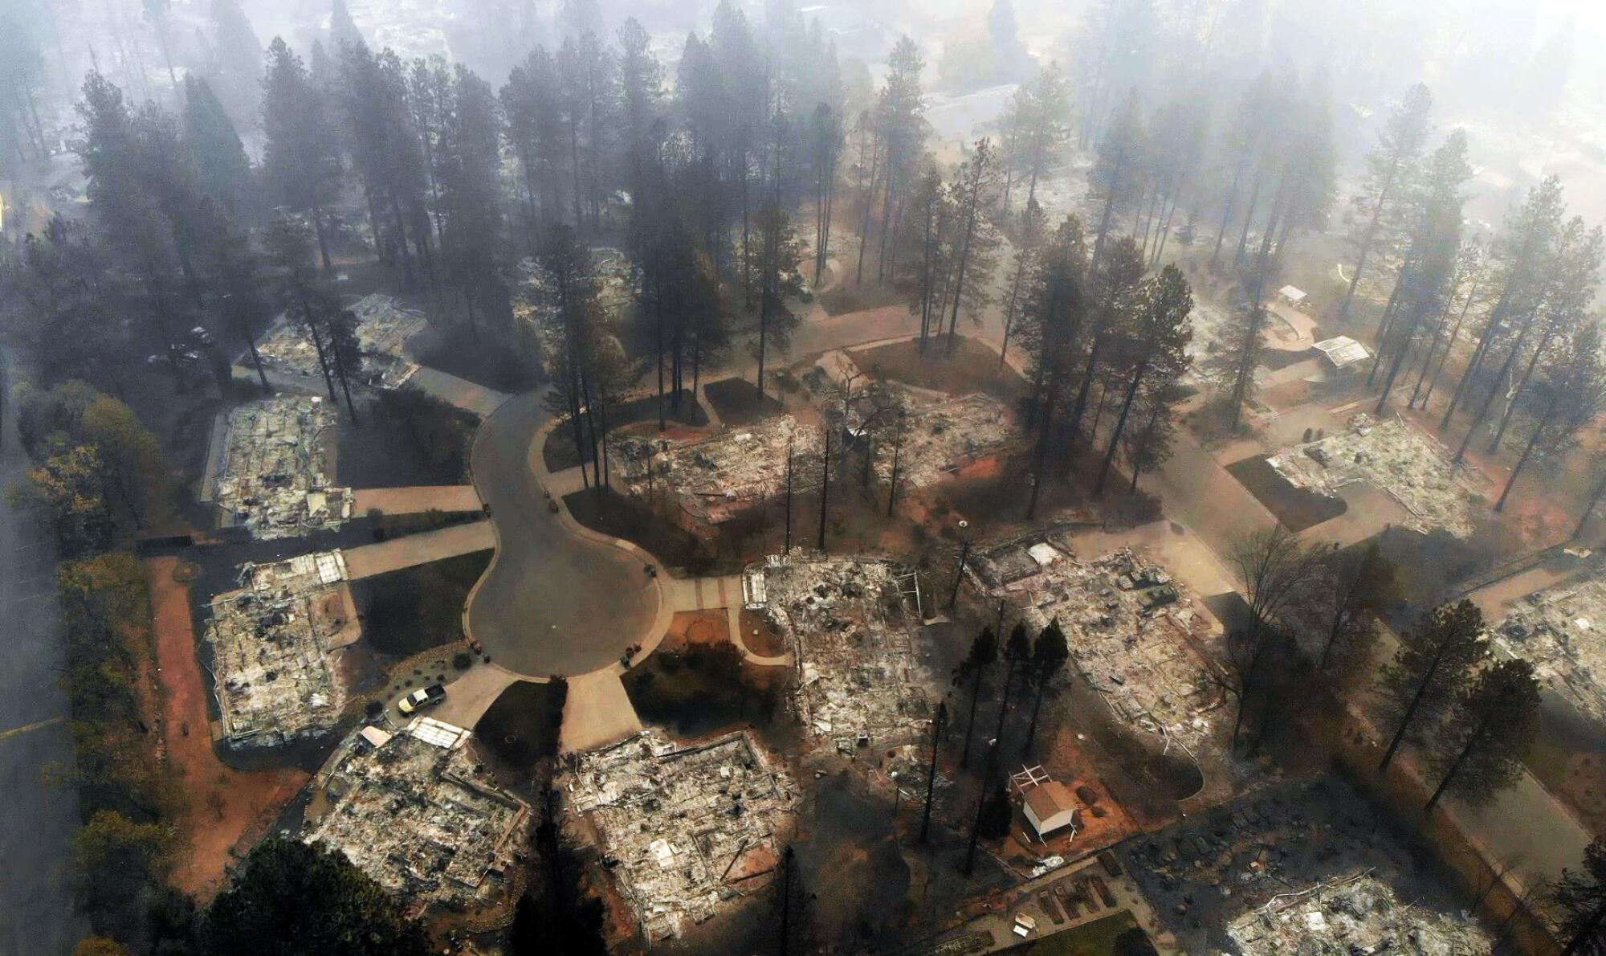
Camp Fire, CA
November 8, 2018
Photo Credit: Carolyn Cole / Los Angeles Times
Notes:
The 2018 Camp fire in California burned over 21,000 ha the day it started, killing 85 people and destroying more than 16,000 homes.

Slide 6
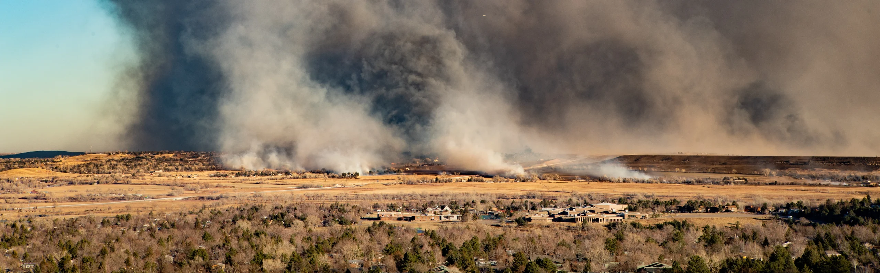
Marshall Fire, CO
December 31, 2021
Photo Credit: NOAA; https://research.noaa.gov/2024/01/08/looking-back-at-colorados-marshall-fire/
Notes:
The 2021 Marshall fire, the most destructive wildfire in Colorado history, was driven by winds over 100 mph; it traveled 3 miles within the hour it started and burned more than a thousand homes.

Slide 7
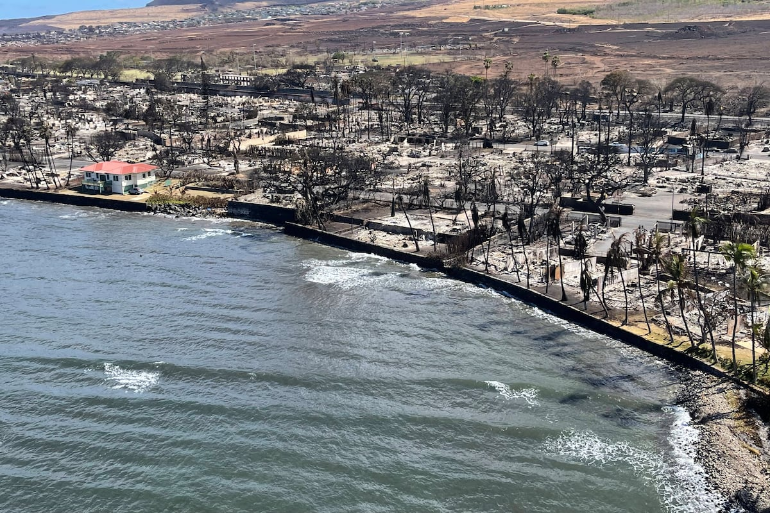
Lahaina Fire, HI
August 8, 2023
Photo credit: Hawai‘i Department of Land and Natural Resources
Notes:
In early August 2023, the devastating Lahaina fire killed 101 people and destroyed more than 2,200 structures when a small brush fire escaped containment and burned through the town to the shore in just two hours.

Slide 8
Speed, not size, is the key factor making wildfires deadly and destructive.
“The modern era of ‘megafires’ is often defined based on wildfire size, but should be defined based on how fast fires grow and their consequent societal impacts … While big fires change air quality, ecosystems, and carbon dynamics, fire speed matters more for infrastructure risk and evacuation planning.”
Notes:
Given these observations, we propose that speed, not size, is the key factor in making wildfires deadly and destructive.
{CLICK}
‘Megafires’ are often defined based on burned area, but we argue that they should be defined based on how fast they grow and their consequent societal impacts.
While big fires matter for air quality, ecosystems, and carbon dynamics, fire speed matters more for infrastructure risk and evacuation planning.

Slide 9
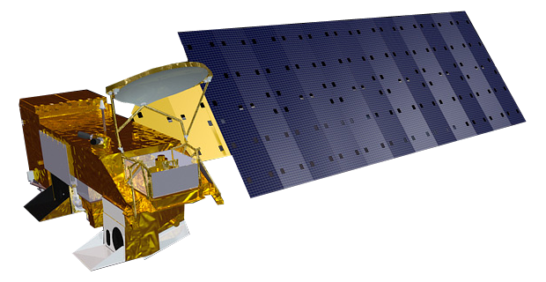
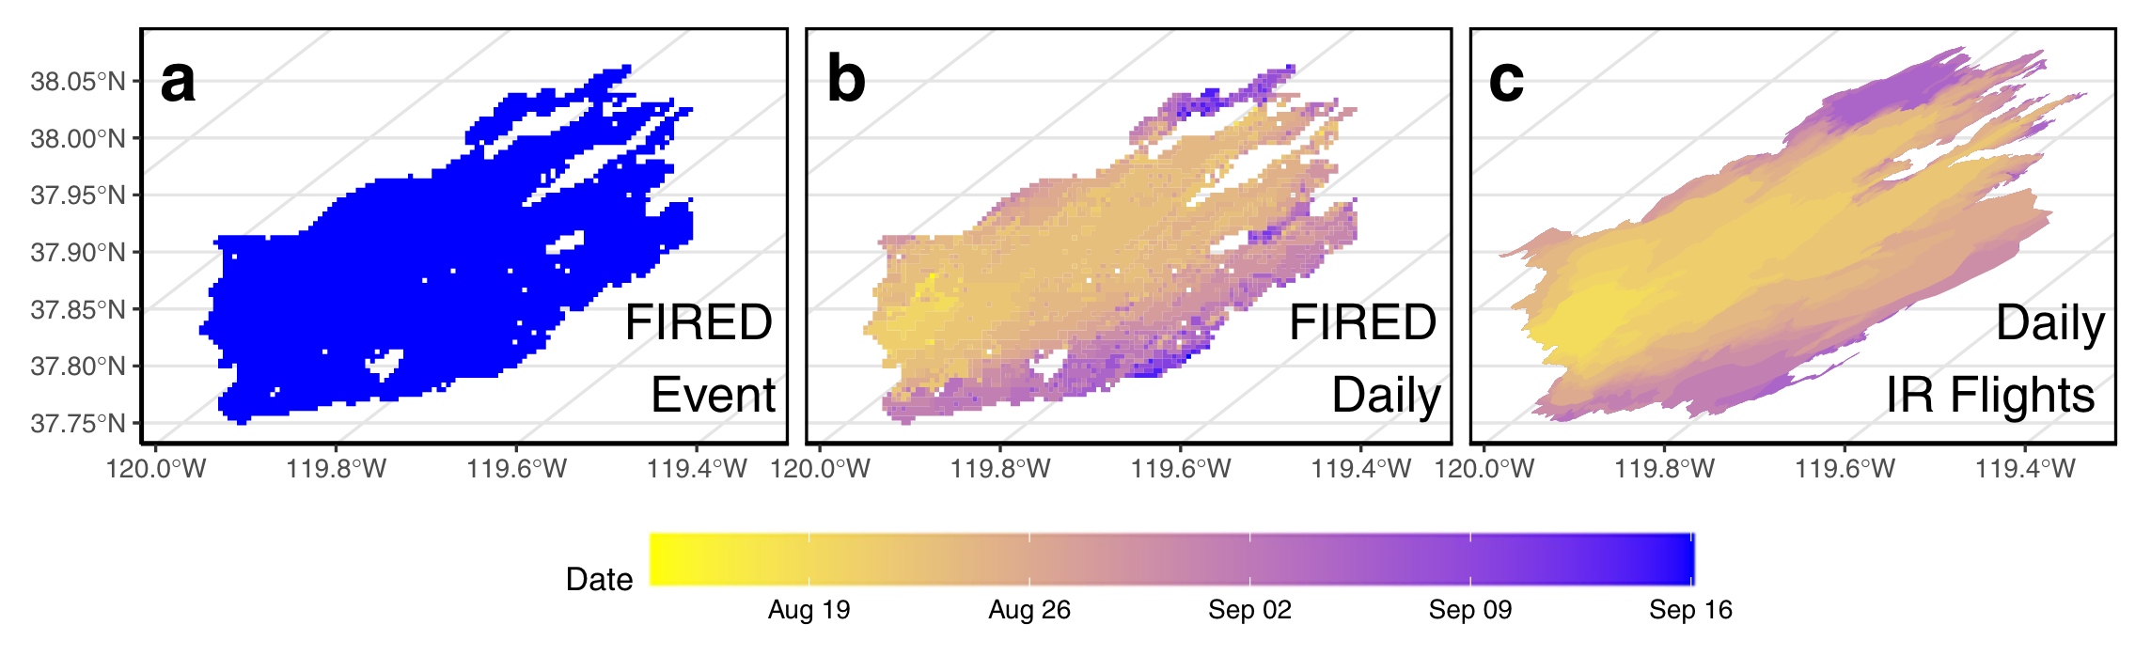

Fire speed has been difficult to track consistently across large regions.
Satellite-derive daily burned area estimates give us a chance to study fire growth rates (FGR) in new ways
MODIS Burned Area Product
Maximum Daily FGR
Notes:
However, fire speed has been difficult to study and thus we lack understanding of the mechanisms and characteristics of extreme fire growth.
This gap in understanding is linked to our lack of national data on fire growth rates (FGR) across events.
{CLICK}
Satellite-derived daily burned area estimates now provide us with unique opportunities to study fire growth rates. Data such as that from the MODIS (and now VIIRS) active fire detections and burned area products are being used to track fire events across large geographic regions.
{CLICK}
We developed an algorithm which delineates fire events and daily area burned based on the MODIS burned area product and enables researchers and managers to create their own fire perimeter data across the globe with a Python wrapper called 'firedpy'.
In this study, we analyzed over 60,000 fire events between 2001-2020 across the contiguous U.S. Using these data, we delineate a critical physical metric that links directly with societal impact:
{CLICK}: the maximum daily fire growth rate. This is a metric which defines the single day maximum area burned during a fire event.
https://www.earthdata.nasa.gov/learn/articles/modis-to-viirs-transition
Mahood, A.L., Lindrooth, E.J., Cook, M.C., Balch, J.K., 2022. Country-level fire perimeter datasets (2001–2021). Sci Data 9, 458. https://doi.org/10.1038/s41597-022-01572-3

Slide 10
What is a fast fire?
Defining fast based on societal impacts, not just area burned
Notes:
So, how do we go from this metric of fire growth rate to defining what is a fast fire?
Fire impacts depend not only on the physical properties of fire but also on the assets in harm’s way. As such, we define fast fires based on a framework that uses social-ecological extremes of both the physical properties and social consequences {CLICK}

Slide 11
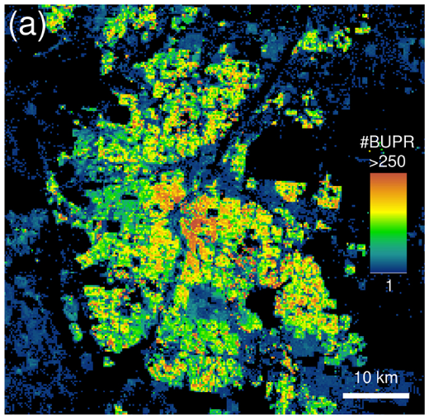
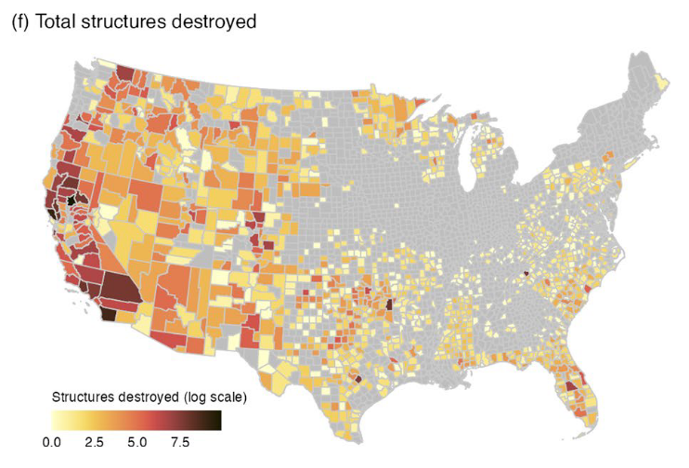
Defining fast based on societal impacts
Physical Properties
Societal Impacts
Satellite Fire Detections
(Maximum Daily FGR)
Property Exposure
Structure damage/destroyed
Notes:
We related this maximum FGR metric {CLICK}
With exposure of the built environment and structures damaged or destroyed to identify a societally-relevant threshold for defining fast fires.
These combined data enable us to explore how fast fires move at a national scale and how that affects residential exposure and societal impacts.

Slide 12
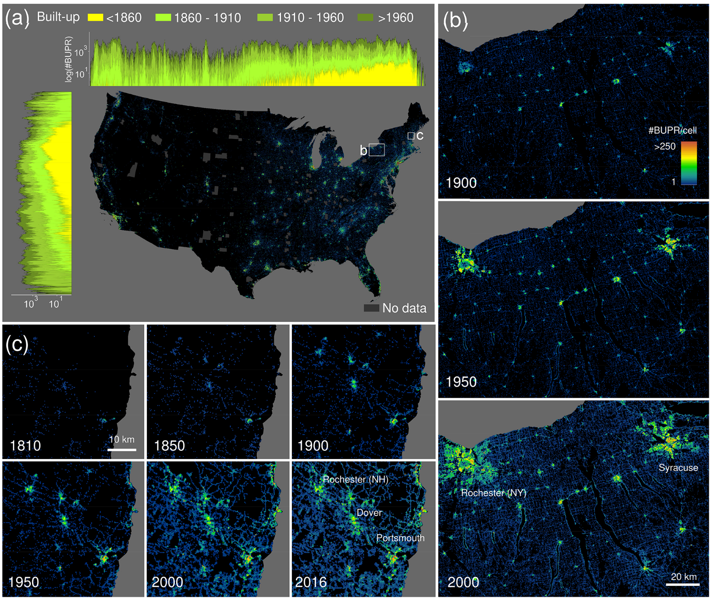
Historic Settlement Data Compilation for the United States (HISDAC-US)
Notes:
We assessed the trends in nearby exposure of the built environment to fast fires using the Historical Settlement Data Compilation of the U.S (HISDAC-US) which is based on Zillow’s Transaction and Assessment Database (ZTRAX) and provides a count of the number of properties within a 250-meter pixels, among other attributes.
The HISDAC-US database offers a unique source of gridded property information at fine spatial (250 m) and temporal (semi-decade) resolutions (1810-2015).

Slide 13
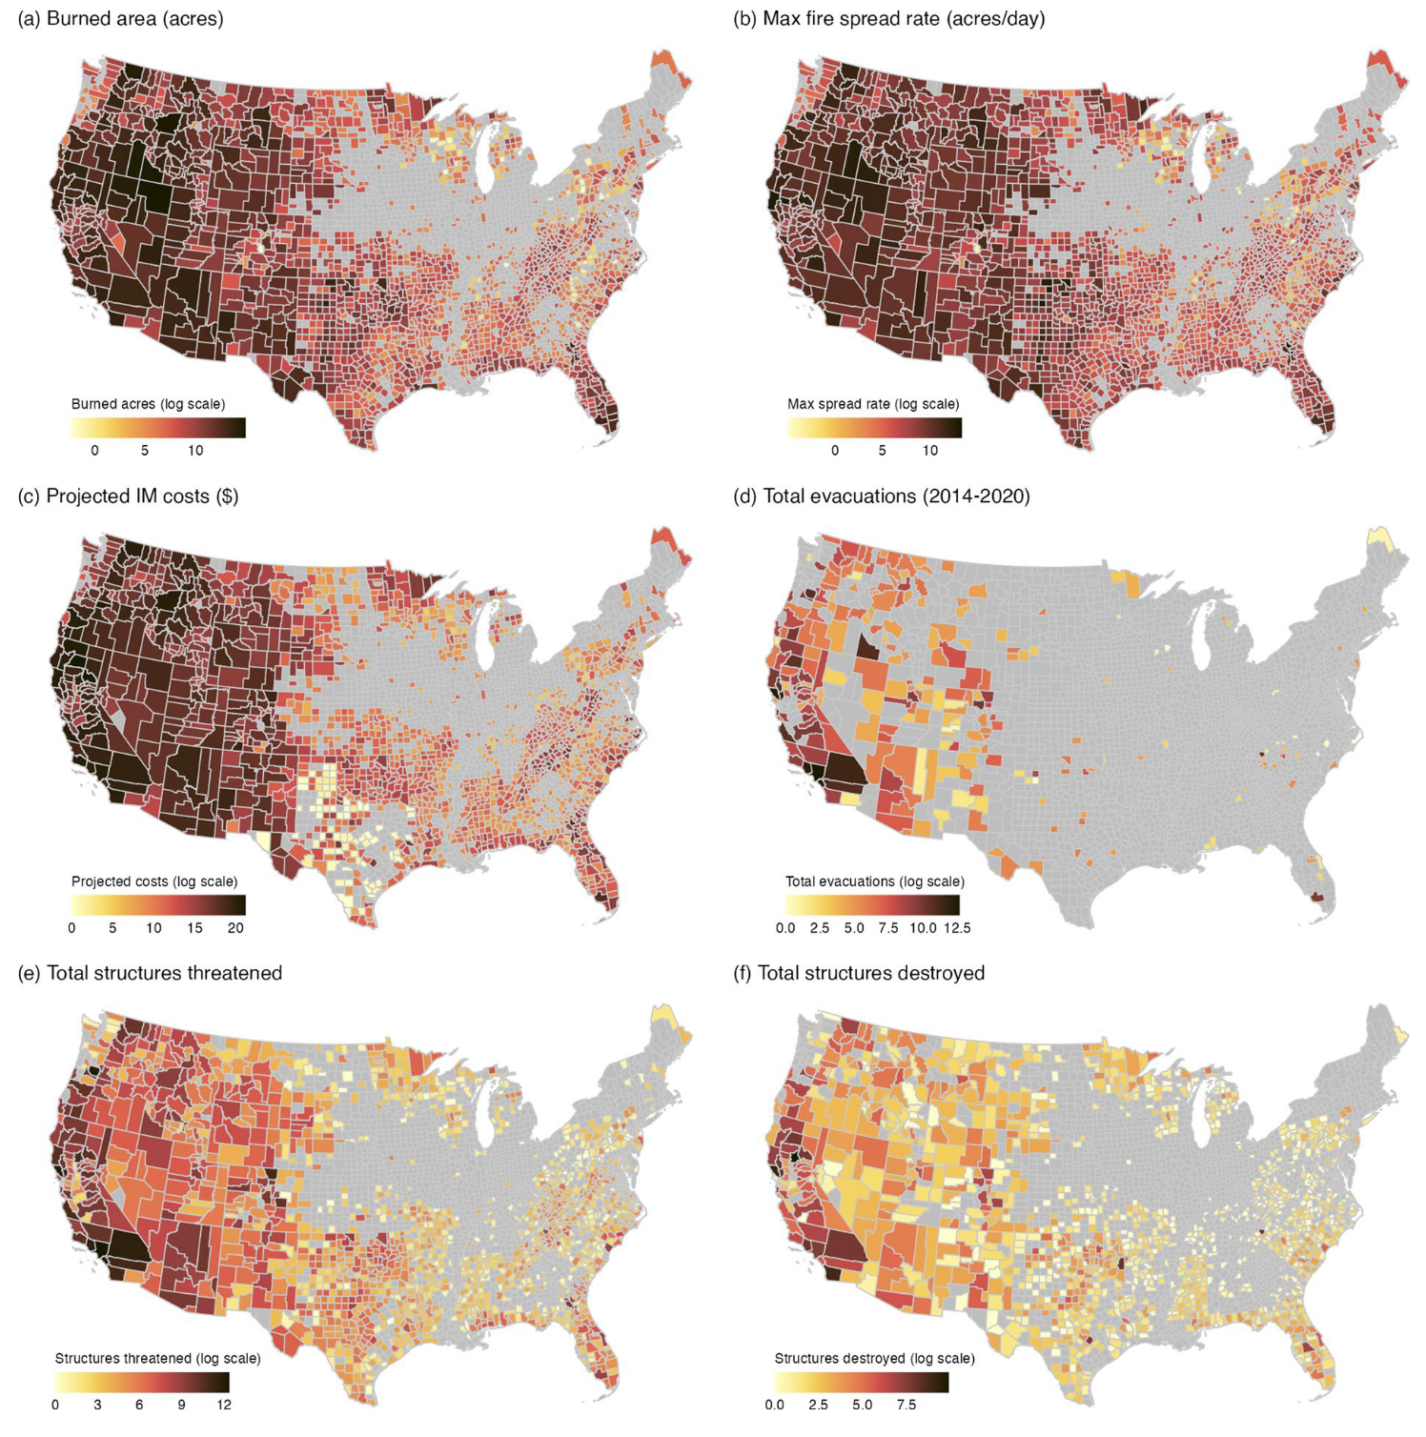
All-hazards Data Mined from the National Incident Management System (ICS-209-PLUS)
Notes:
We combine this with government records documenting emergency management activities during an active fire. This dataset, the ICS-209-PLUS, enables exploration of the societal consequences of wildfires such as how many structures were damaged or destroyed on a daily basis.
{CLICK}
The aggregation of ICS-209 reports provides the best available information on the high costs of U.S. wildfires at a national scale. From these data, we can assess the amount of money spent on suppression activities, the number of resources deployed, and the values at risk.

Slide 14
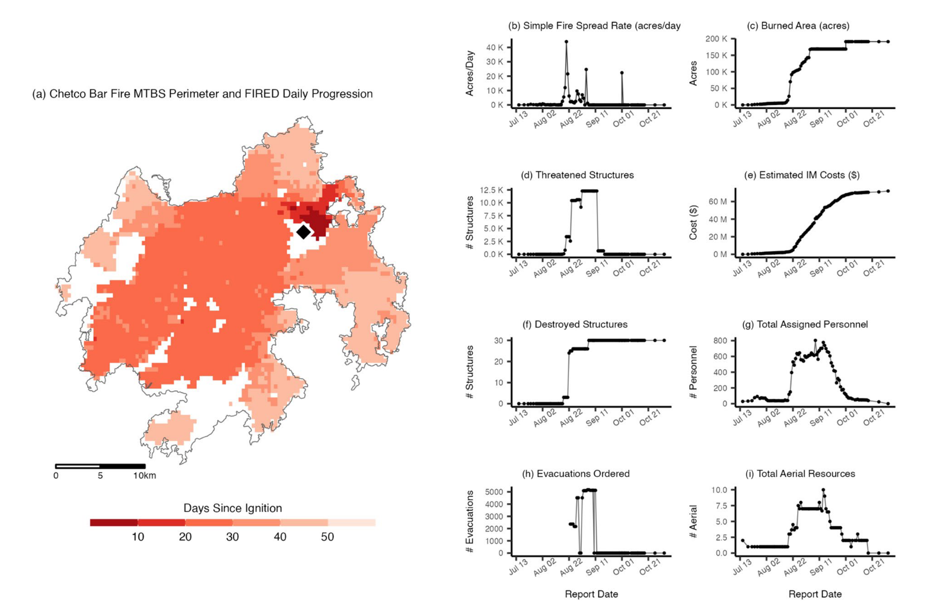
All-hazards Data Mined from the National Incident Management System (ICS-209-PLUS)
Notes:
Importantly, the ICS-209-PLUS data contains event summary reports as well as daily situation reports which provide important snapshot of wildfire behavior, suppression responses and resource use, and status of values at risk such as structural impacts.
{CLICK}
Along with satellite-detections of FGR, we have a unique ability to combine the areal growth of a fire and the on-the-ground status of incident management.

Slide 15
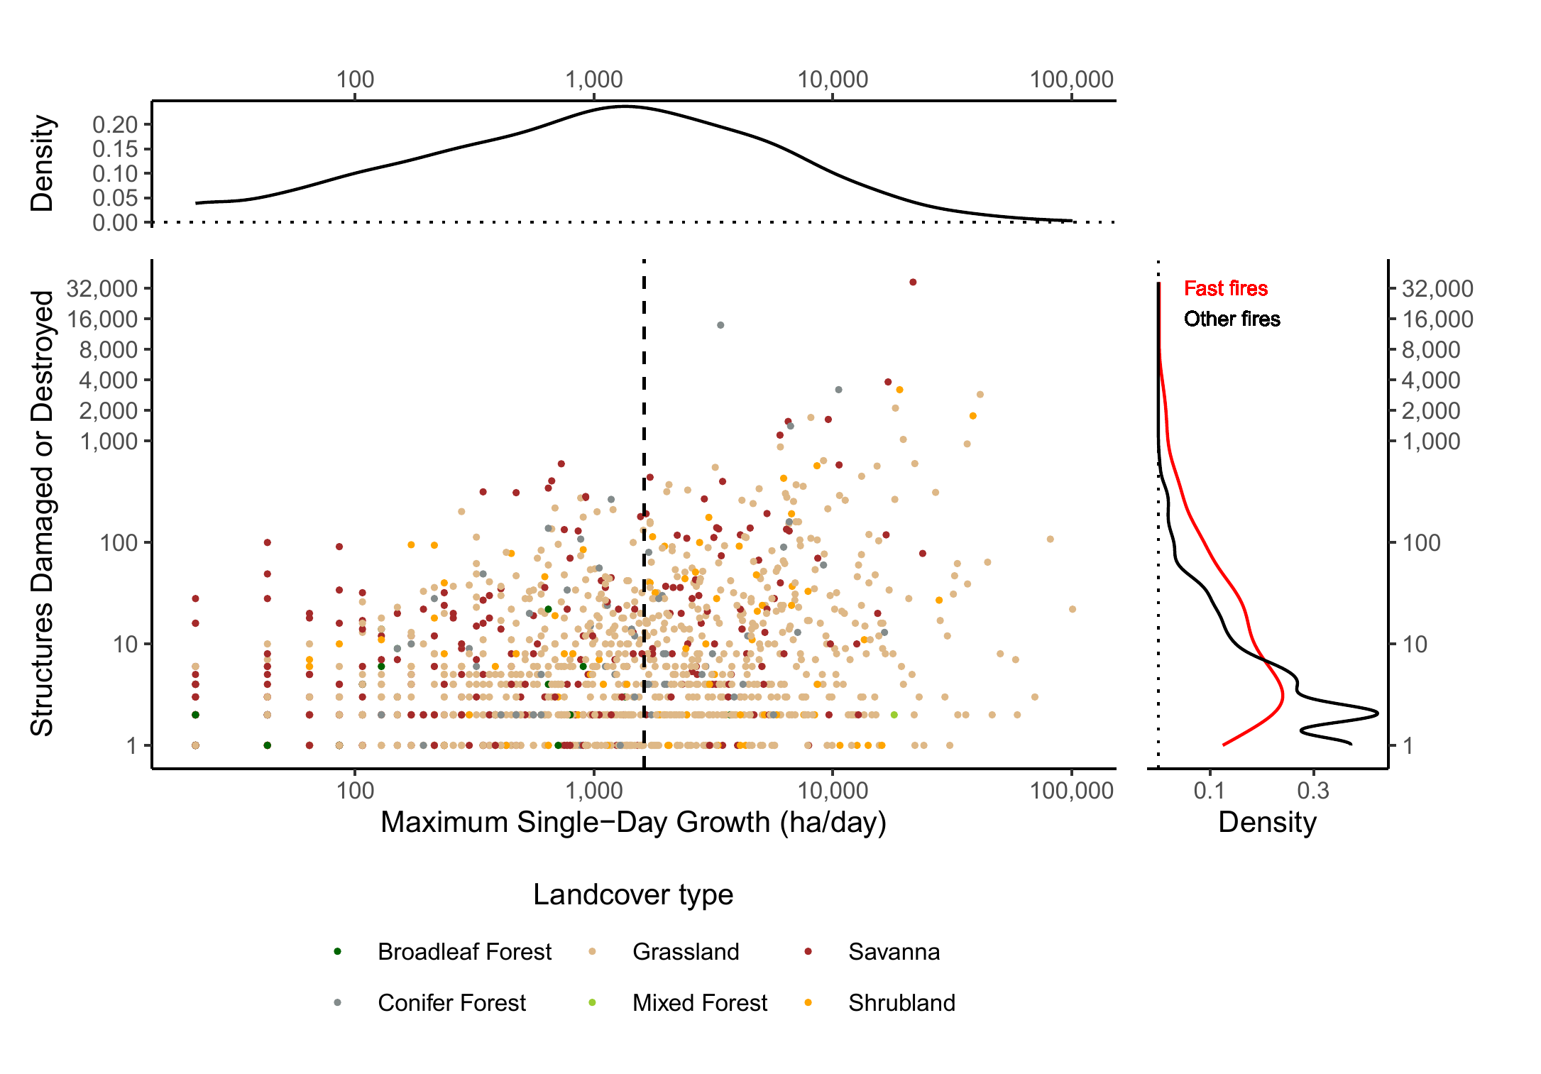
Defining fast based on societal impact
Regression Decision Tree
Structure Impact ~ log(Maximum FGR)
0
1
1
0
1
0
1
0
1 = Fast
0 = Not Fast
Notes:
So, defining fast fires using a combination of these data required partitioning fire into two categories: fast and not fast.
{CLICK}
To do this, we built a regression decision tree which related maximum single day fire growth rate with the number of structures damaged or destroyed.
{CLICK}
This allowed us to identify a threshold for "fast" based on the likelihood that a fire was causing significant societal impacts.
{CLICK}

Slide 16
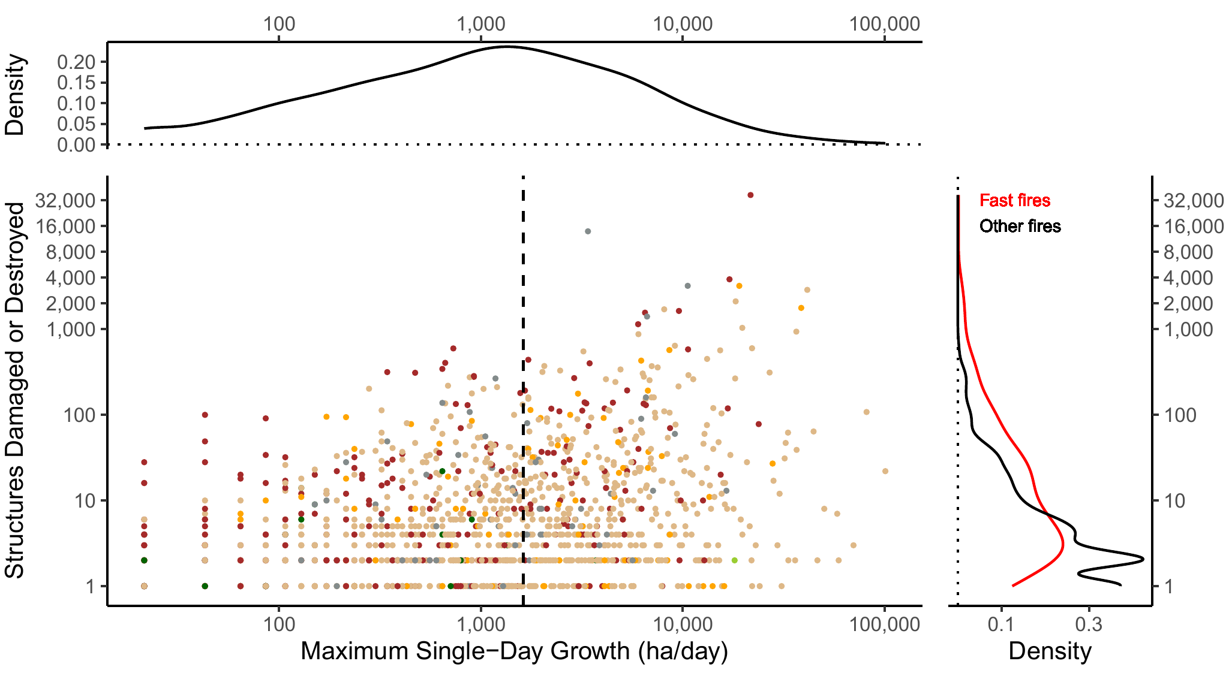
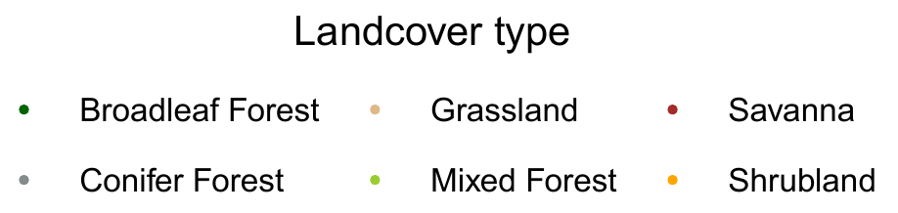
Defining fast based on societal impact
1,620 ha/day
grasslands, savannas, and conifer forests
Notes:
There is a lot going on in this figure, so let's break it down a bit. On the x-axis, we have the maximum single day fire growth rate (ha/day) and on the y-axis we have the number of structures damaged or destroyed. The density plot at the top of the figure shows the distribution of fire growth rates and on the right we show the distribution of destroyed or damaged structures by fast and not fast fires.
{CLICK}
Based on the regression tree model, fires growing faster than 1,620 ha on any single day were far more likely to destroy or damage structures.
{CLICK}
This is also observed in the distribution of structures damaged or destroyed.
{CLICK}
We also observe that fast fires predominantly occur within grassland, savanna, and conifer forest landcover types, in that order.

Slide 17
Defining fast based on societal impact
1,620 ha/day
Only 2.7% of total fire events, but …
~80,700 structures destroyed (78% total, 88% of residential properties)
$18.9 Billion in suppression costs (61%)
~3M residential properties exposed (within 4km of fast fire perimeters)
Notes:
So, fires which exceed this threshold (our "fast fires") represent only 2.7% of all events
{CLICK}
Yet they account for ...
78% of total structures damaged or destroyed (88% of residential properties)
{CLICK}
$18.9 Billion in suppression costs
{CLICK}
~3M residential properties were within 4km of a fast fire perimeter
It is important to note that this is a nationwide threshold and reflects if there was any structure loss at all. Of the fires that damaged or destroyed more than 100 structures (N = 71), their average maximum daily growth was 8,569 ha per day (median = 4,916 ha per day). Moreover, there are important differences across states. For example, California has by far the highest structure loss compared to other states (N = 66,715 structures damaged or destroyed) and exhibits a fast fire threshold of 2,870 ha/day.

Slide 18
Where do fast fires occur?
Notes:
Now that we have defined fast fires, we can look at the geographic distribution of them across the conterminous US.
We also observe the temporal trends in fire speed across the time period of this analysis.

Slide 19
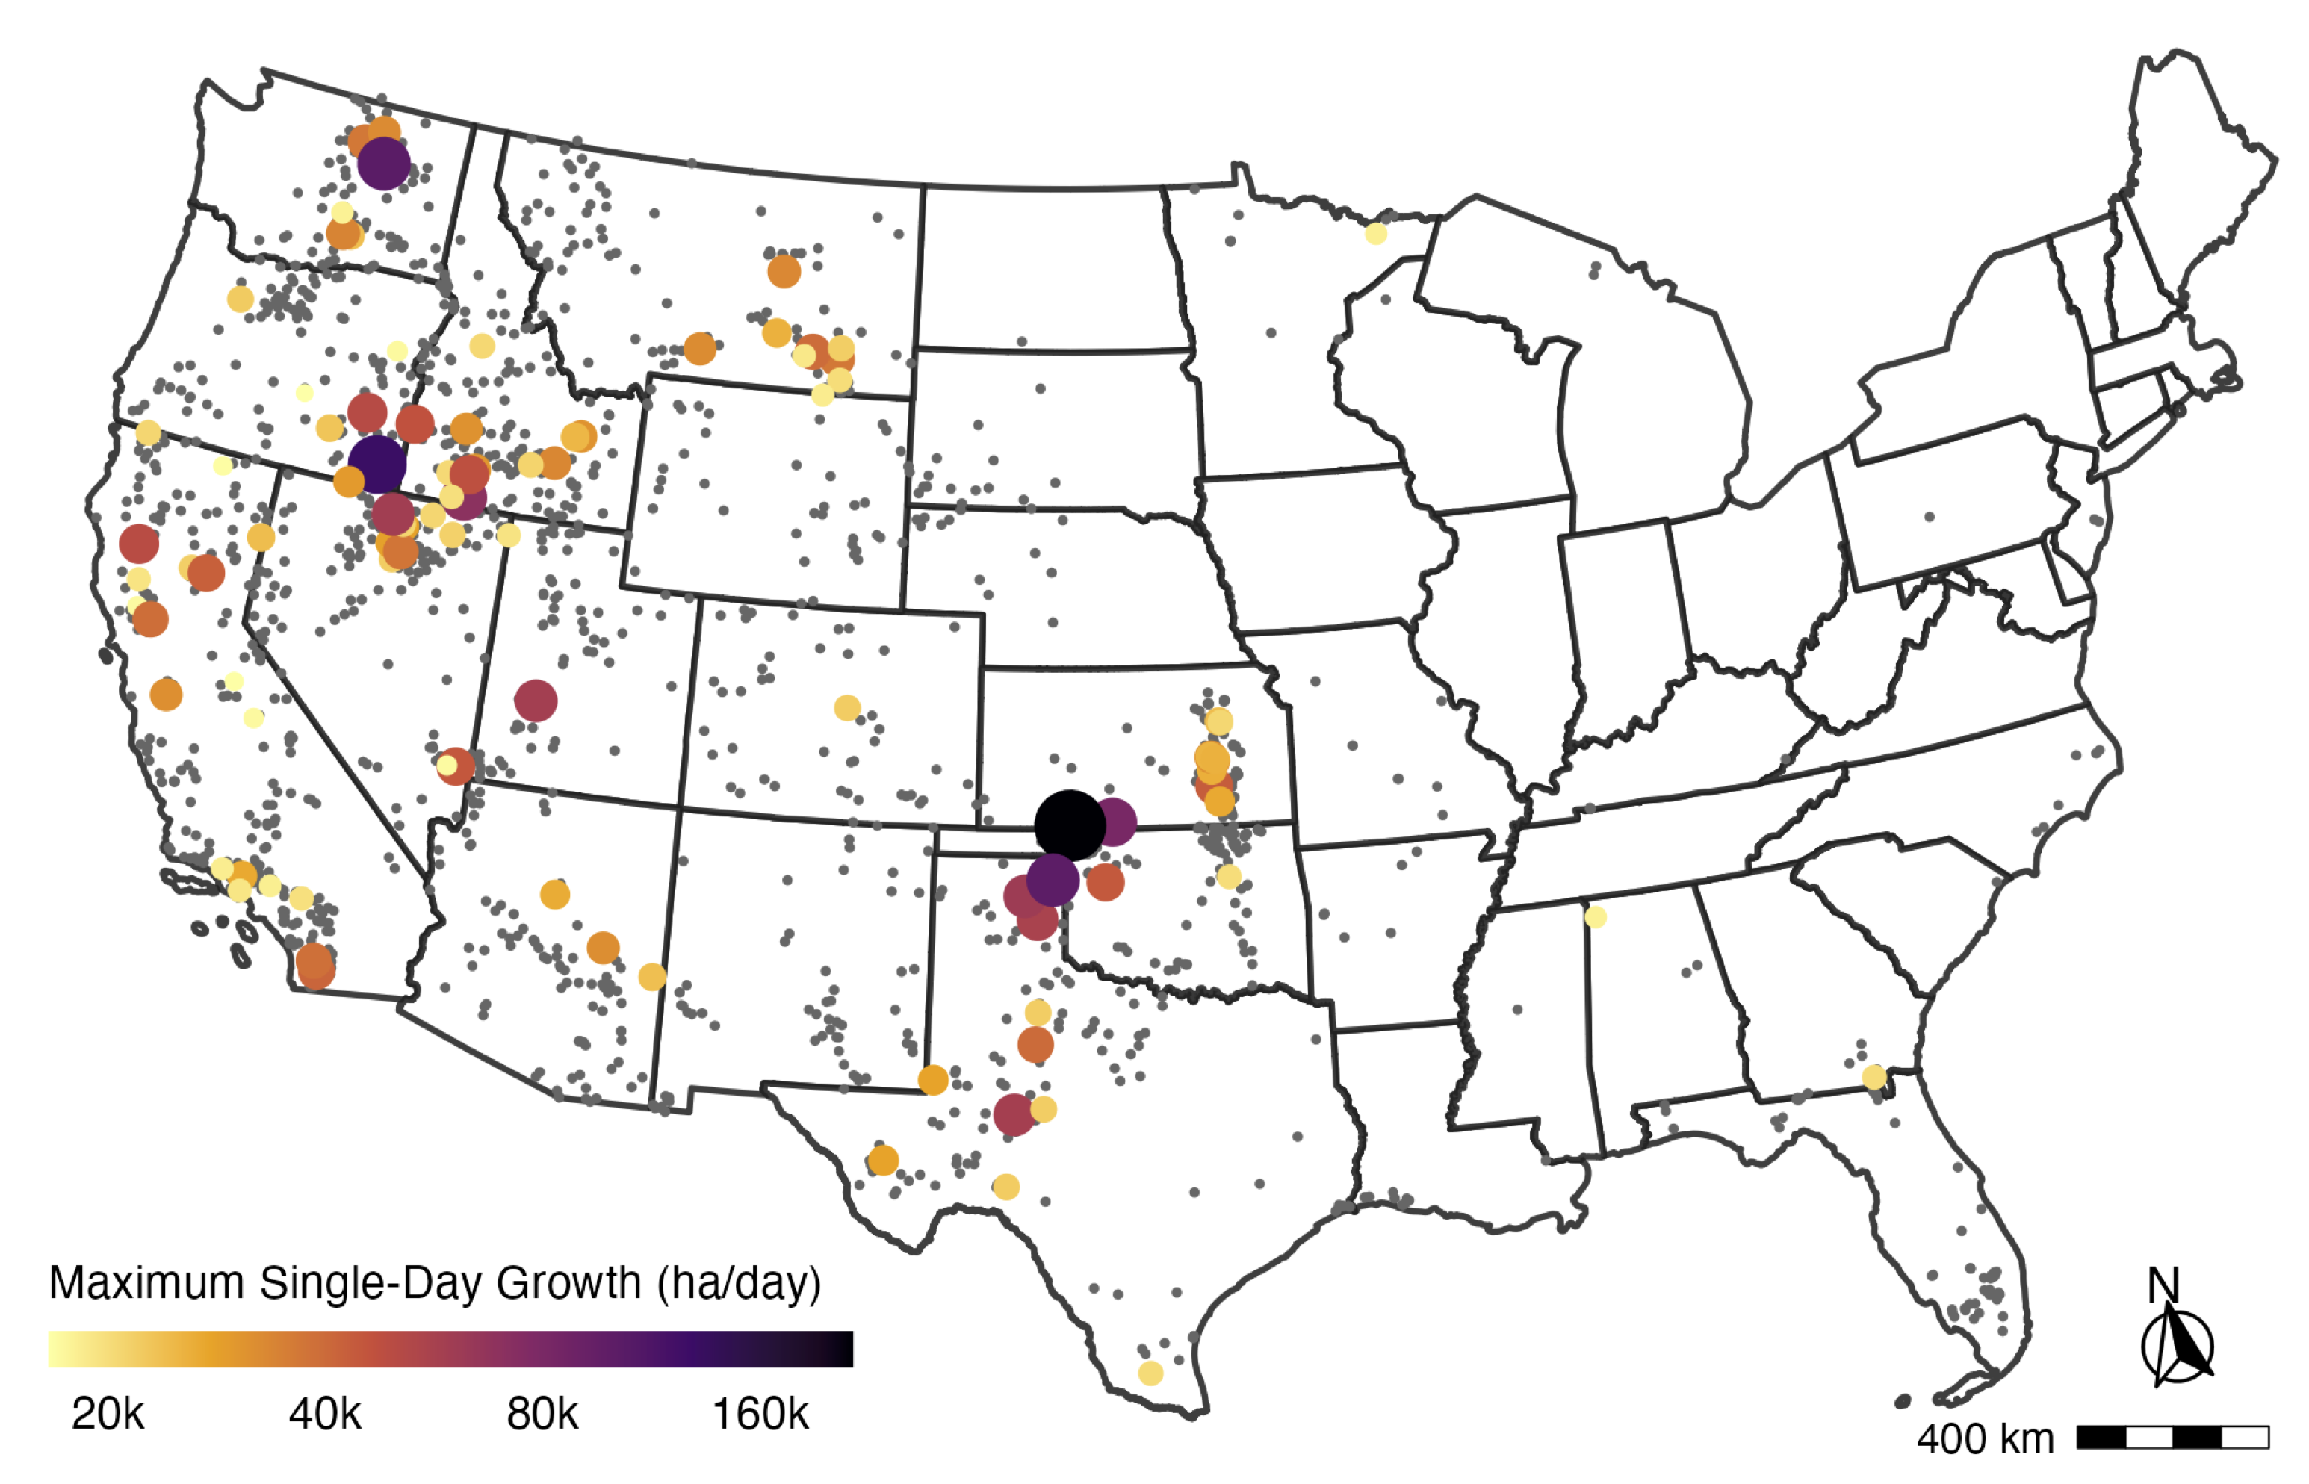
Mostly in the Western US and Great Plains
Notes:
As it turns out, fast fires primarily occur in the western U.S. and Great Plains regions.
The fastest fires are predominantly in grassland systems, where flashy fine fuels can carry fire rapidly across the landscape.
This map shows the the top 100 fastest fires in the US, with the color and size representing the maximum single day FGR.

Slide 20
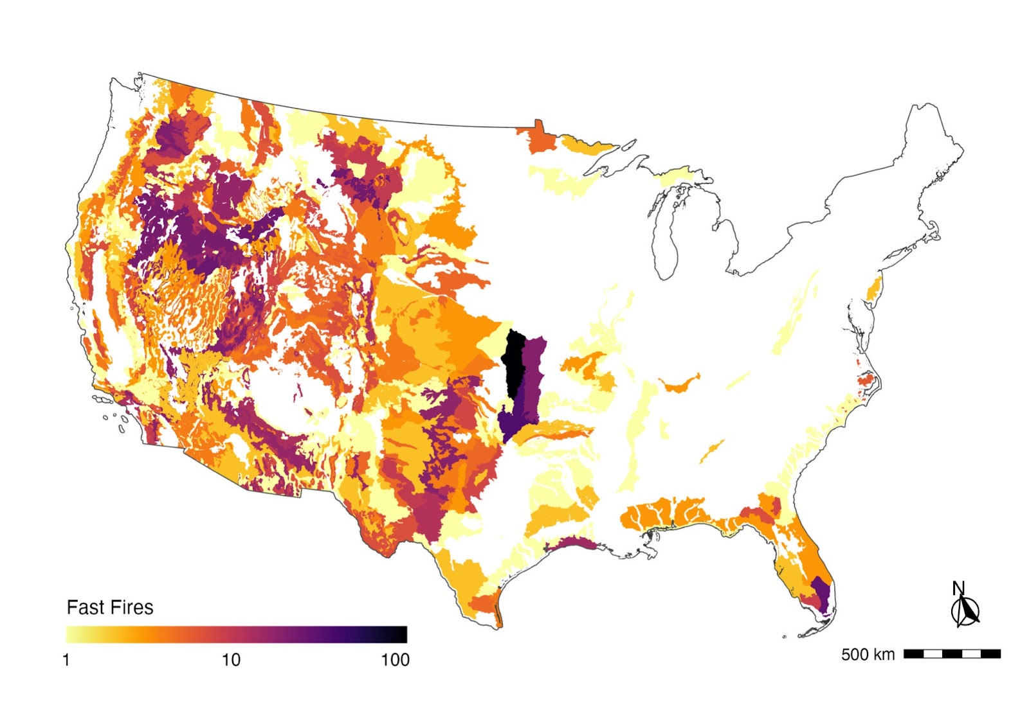
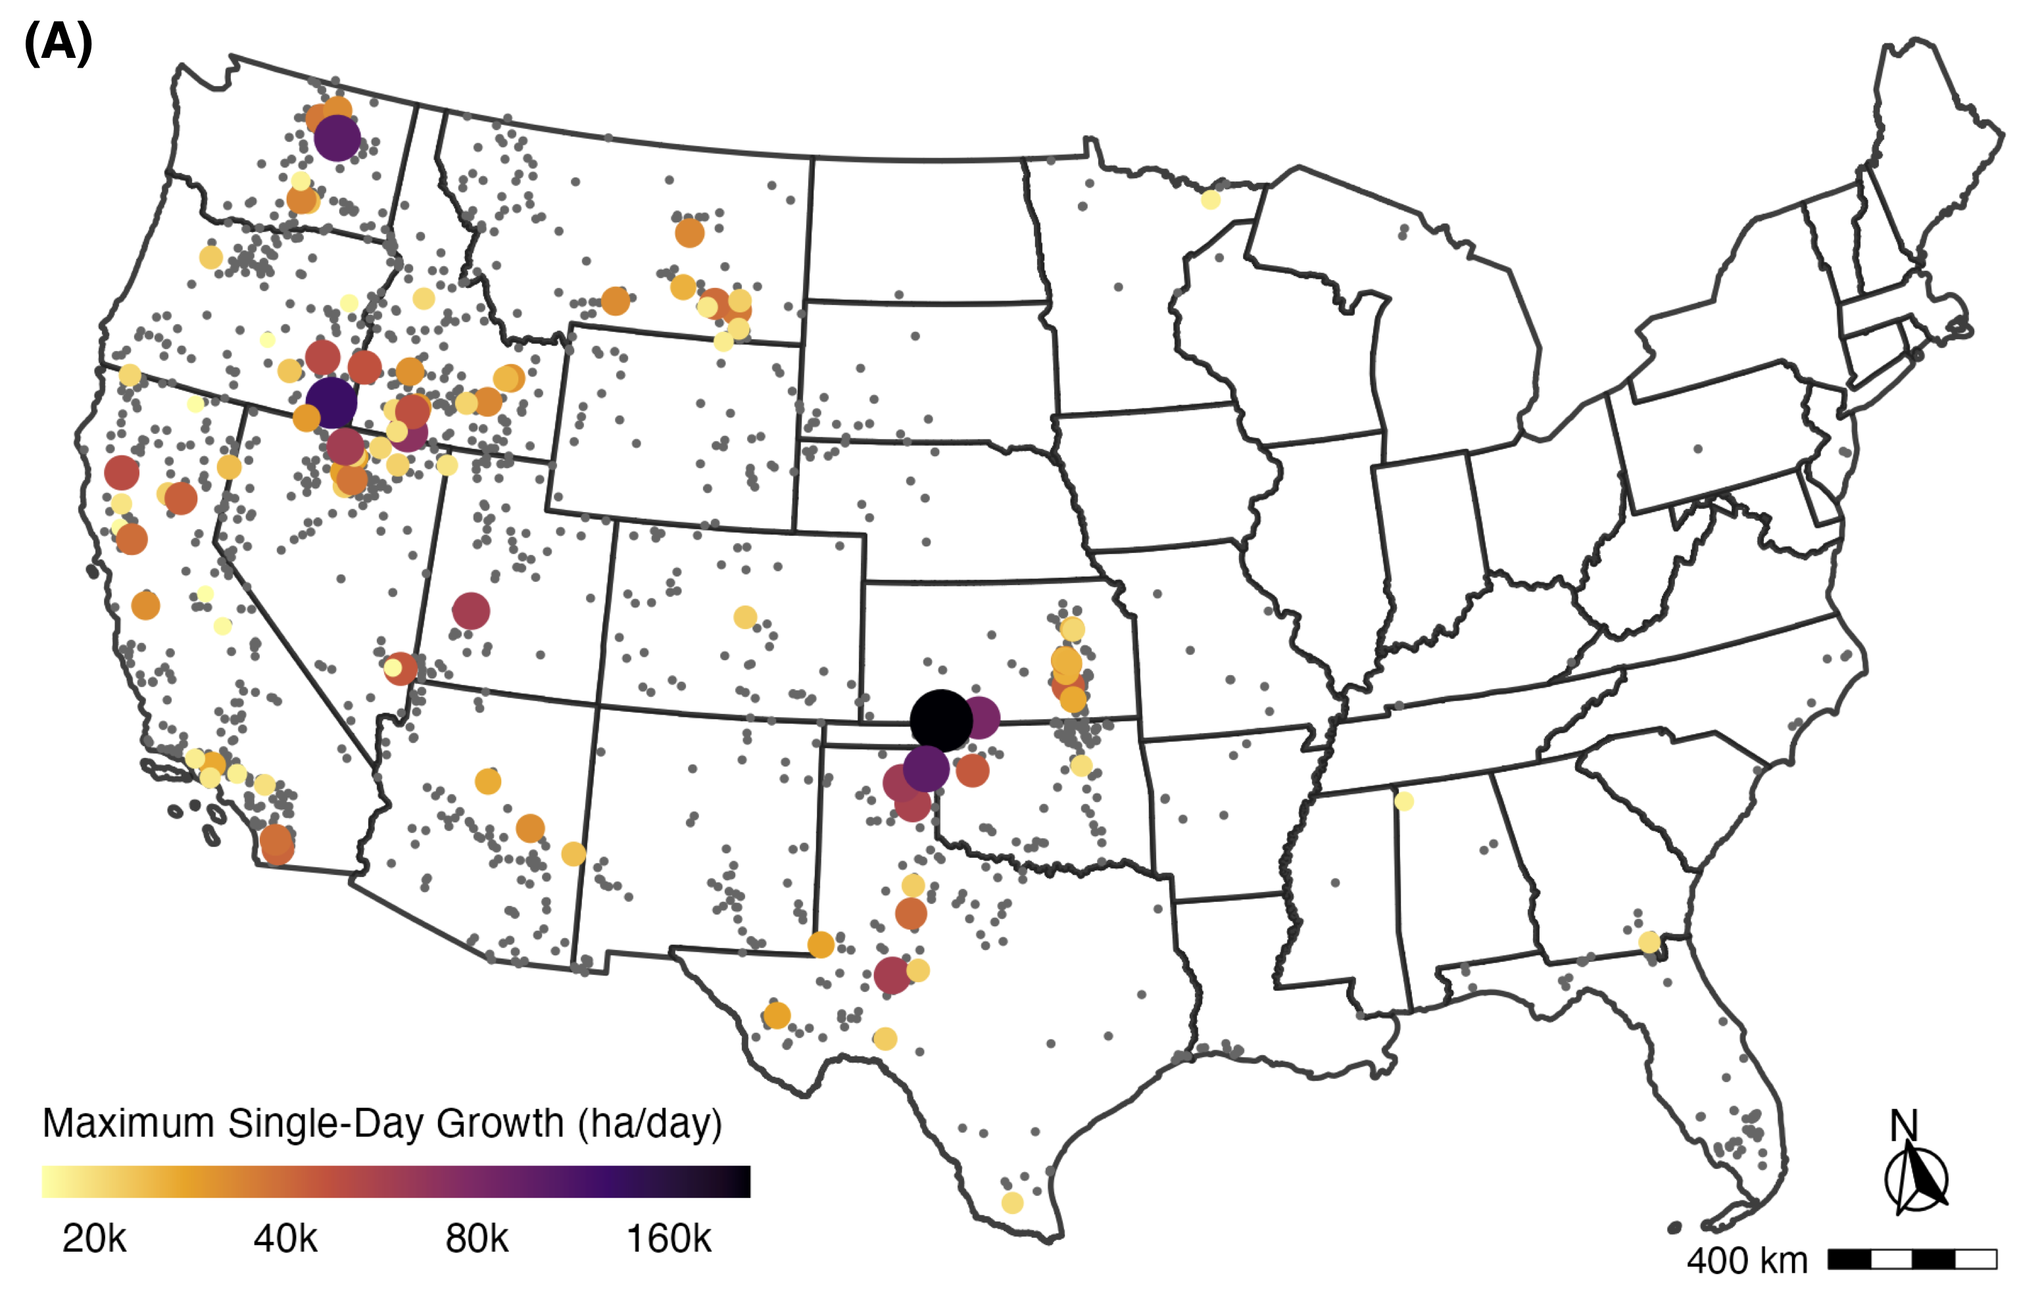
Across US EPA Level IV Ecoregions
Columbia Plateau
Central Great Plains/Flint Hills
Northern Basin and Range / Northwestern Forested Mtns / Idaho Batholith
Notes:
Looking at the spatial pattern of fast fires by US EPA Level IV ecoregions, we see that some areas have a greater density of fast fires such as the northwestern basin and range, the Columbia plateau, and the central great plains / flint hills region.

Slide 21
Are fires getting faster?
Notes:
We also investigated whether there is a trend in the speed of fire growth across our time period from 2001-2020.

Slide 22
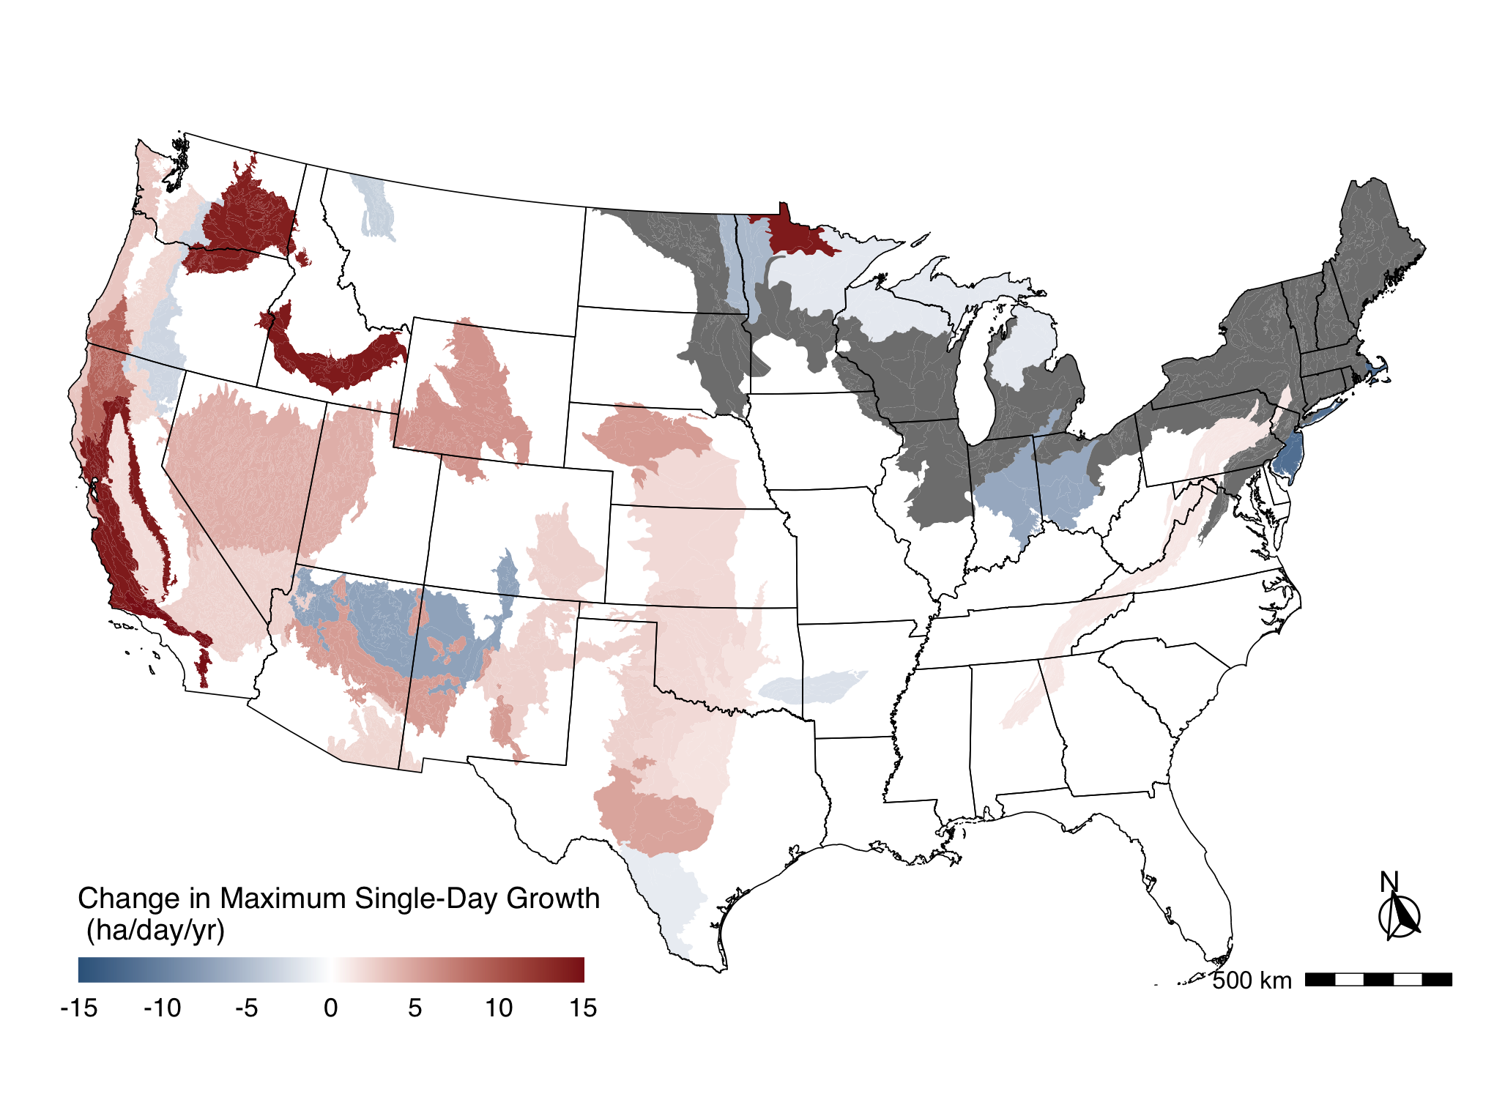
Fire are also getting faster in X ecoregions
Notes:
For all fires, maximum FGR significantly increased in 20 of the 84 level III ecoregions (mainly in the western U.S.). Maximum FGR significantly decreased in 9 of the ecoregions).
Importantly, most of California’s ecoregions and coastal Oregon and Washington exhibited an increase in fire growth rate over this period. Most pronounced were the increases in event-level spread and daily growth rates in mediterranean California, with an increase of 300 ha/day in maximum daily growth in Southern California Mountains.

Slide 23
Implications/Takeaways
What can we do with this information?

Slide 24
Key Takeaways
We delineate a new class of the fastest growing and most destructive fires, or ‘fast fires.’
Fast fires matter for life safety and structure impacts; large fires matter more for ecosystems and generate significant smoke.
Fast fires overall accounted for 88% of residential structures destroyed in the U.S. (2001-2020)
Fires are growing significantly faster across nearly half of the contiguous U.S. land area—and 2.5 times faster across the western U.S. in just 20 years.
Notes:
This class is akin to ‘mega-fires,’ but is defined based on a maximum daily growth rate of more than 1,620 ha/day where we document the majority of structures destroyed (78%) and suppression costs (61%)

Slide 25
Management Implications
Fire speed may determine firefighter decision-making and/or how effective suppression operations can be near communities.
With the fastest fires occurring in grasslands, we need to rethink grassland fire management strategies.
Home hardening measures are critical (defensible space, fire-resistant materials, etc.)
Increasing speed will challenge emergency response, evacuation plans, and community preparedness.
Early warning systems for evacuation
Better evacuation plans for communities
Integrating fire speed into measures of community wildfire risk
Notes:
The speed of a fire determines first whether firefighters are more focused on evacuation than home protection (17),
and second how effectively they can extinguish burning firebrands and new ignitions on structures before the home becomes fully involved (38, 39).
Additionally, we quantify that the fastest growing fires are in grassland systems where more homes have been destroyed, relative to forest wildfires (51)—highlighting the need to rethink grassland fire management strategies.

Slide 26
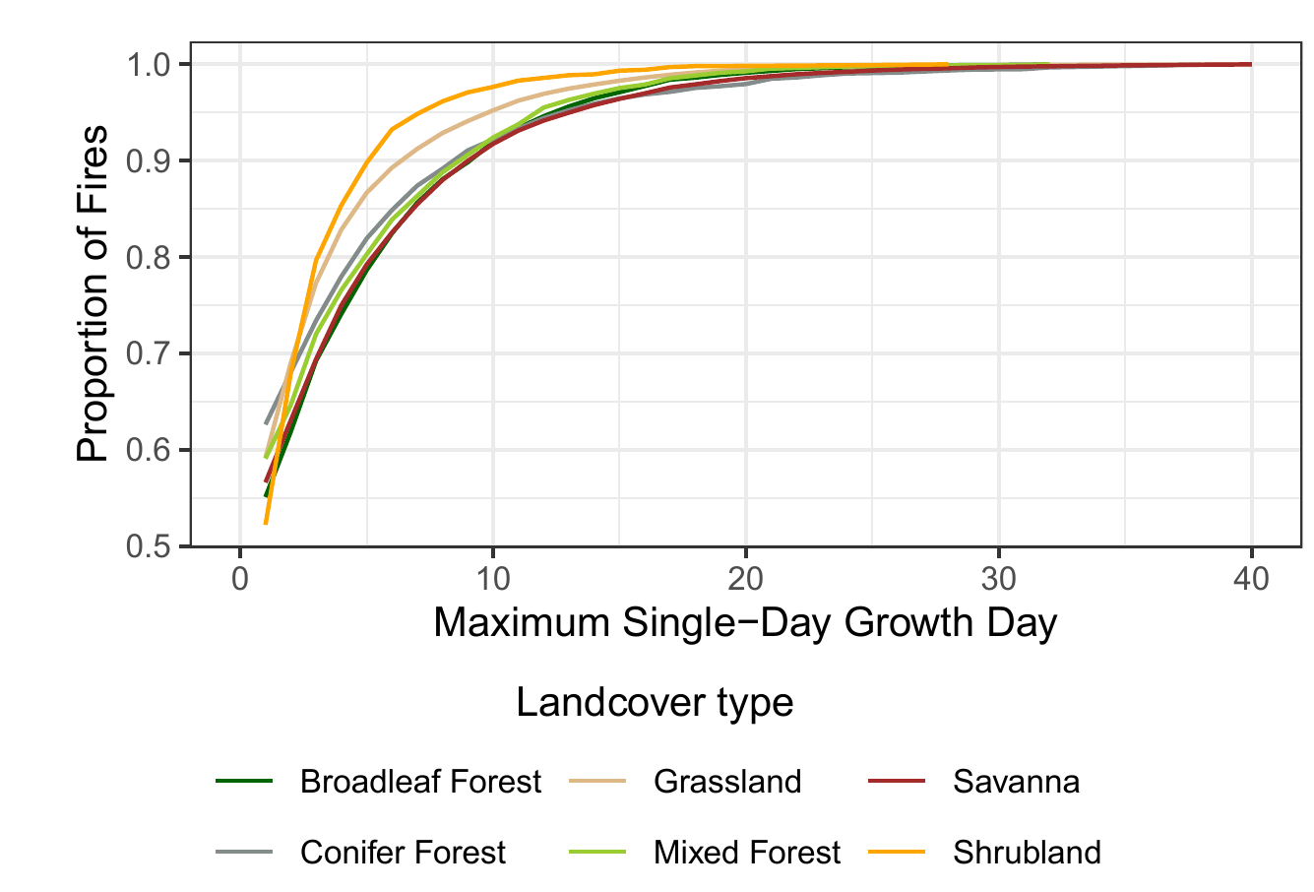
Management Implications
83% of events reach their maximum growth rate within five days.
Notes:
Additionally (and I promise this is the last figure), with maximum daily growth occurring within the first five days after ignition for 83% of all events, we also need to focus on proactive measures that slow fires down or promote fire resilience of the built environment.

Slide 27
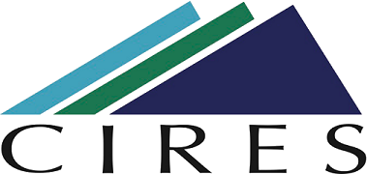






Acknowledgements
Author Affiliations:
¹Environmental Data Science Innovation and Inclusion Lab (ESIIL), University of Colorado Boulder; Boulder, CO, United States
²Department of Geography, University of Colorado Boulder; Boulder, United States
³Earth Lab, Cooperative Institute for Research in Environmental Sciences (CIRES), University of Colorado Boulder; Boulder, United States
⁴Water Resources, Agriculture Research Service, United States Department of Agriculture; Fort Collins, United States
⁵Research Applications Laboratory, National Center for Atmospheric Research; Boulder, United States
⁶Department of Geography, University of California Los Angeles; Los Angeles, United States
⁷University of California Merced, Management of Complex Systems Department, School of Engineering; Merced, United States
*Corresponding author. Email: Jennifer.Balch@colorado.edu

Slide 28
Thank You!
maxwell.cook@colorado.edu
Department of Geography, University of Colorado Boulder
Manuscript is accepted at Science and due for publication in mid-September (currently under embargo). Keep an eye out!
FIRED Dataset/Python CLI

Slide 29
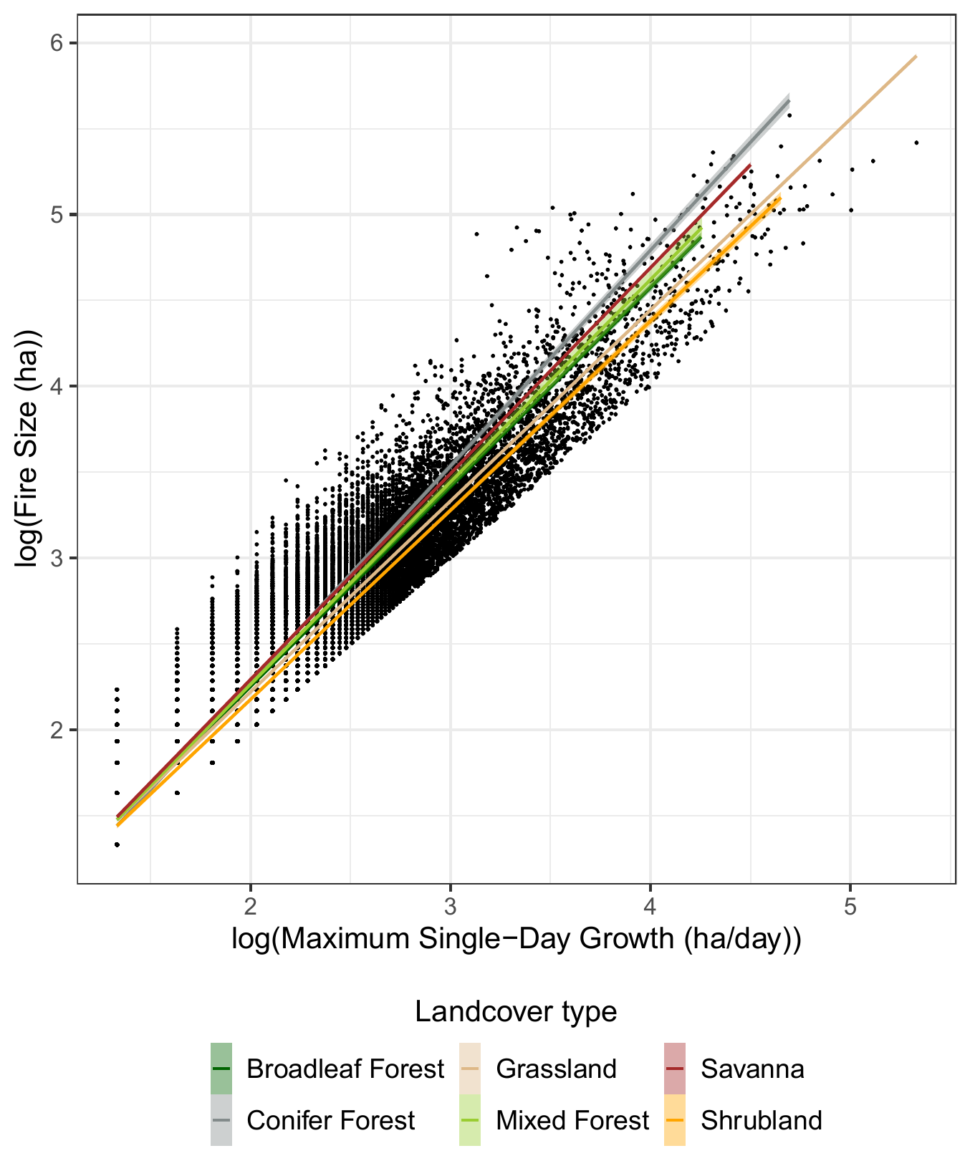
Strong relationship between speed and size
Notes:
The maximum FGR is very strongly associated with final fire size across land cover types (Fig. S1), with the log-log relationship suggesting that it follows a power law distribution (adjusted R² = 0.97). The importance of this is that extreme fire weather on individual days is driving fire growth and has consequences for suppression efforts (45)

Slide 30
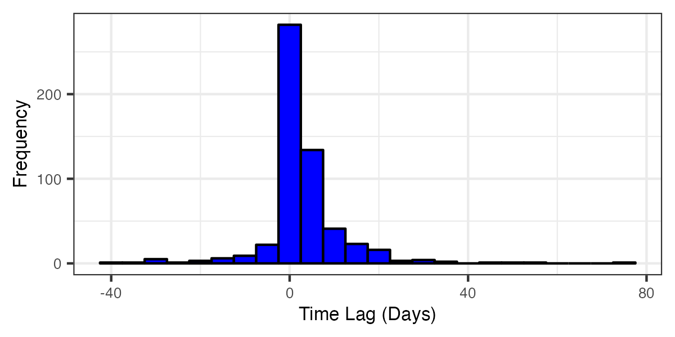
Strong relationship between time of maximum growth and time of structure loss
Notes:
The maximum FGR is very strongly associated with final fire size across land cover types (Fig. S1), with the log-log relationship suggesting that it follows a power law distribution (adjusted R² = 0.97). The importance of this is that extreme fire weather on individual days is driving fire growth and has consequences for suppression efforts (45)

